Slide 1
MODULE -4
Image Segmentation

Slide 2
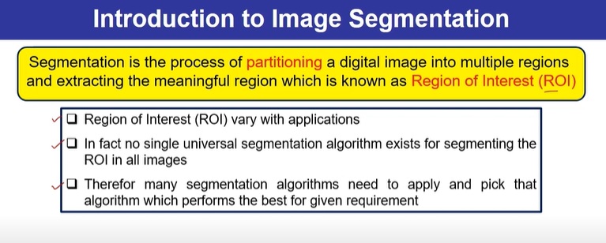

Slide 3
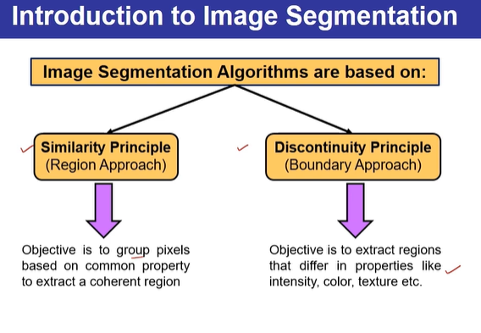

Slide 4
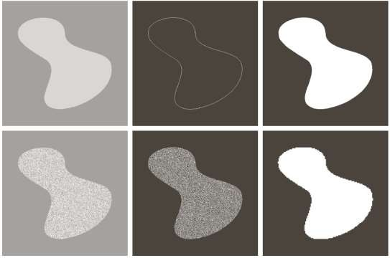

Image Segmentation

Slide 5
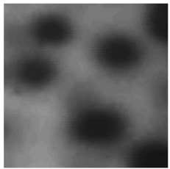
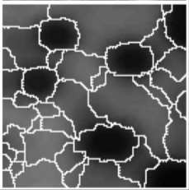
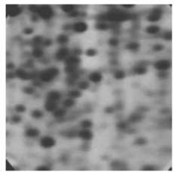
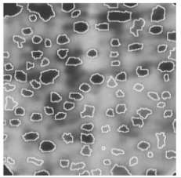
Image Segmentation

Slide 6
Detection of Discontinuities
  There are three basic types of gray-level discontinuities: points , lines , edges
  The common way is to run a mask through the image.

Slide 7
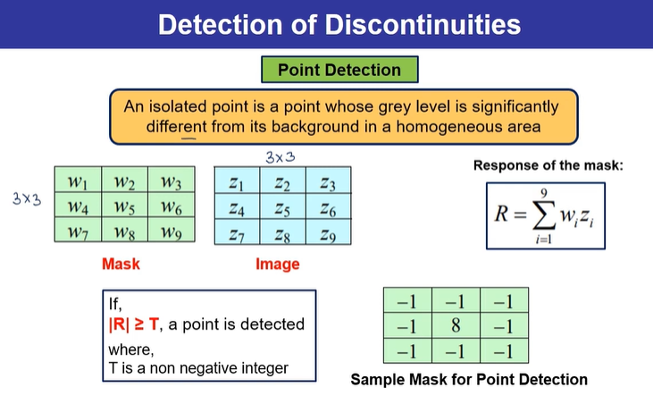

Slide 8

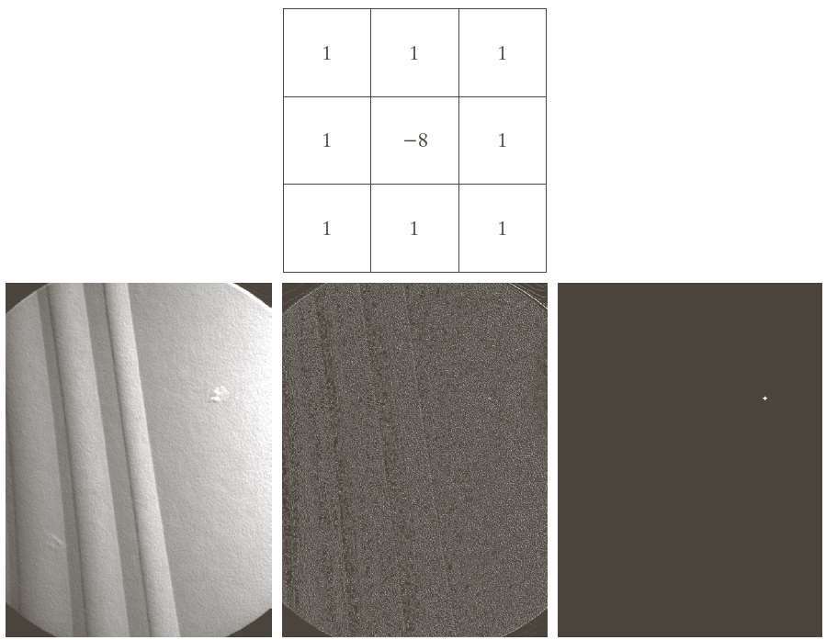
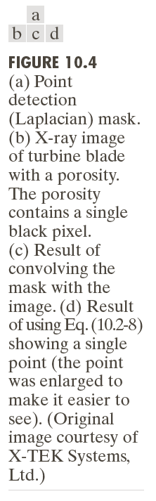
Point Detection

Slide 9
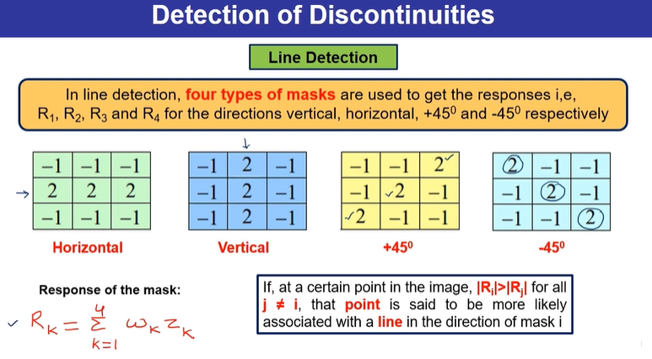

Slide 10
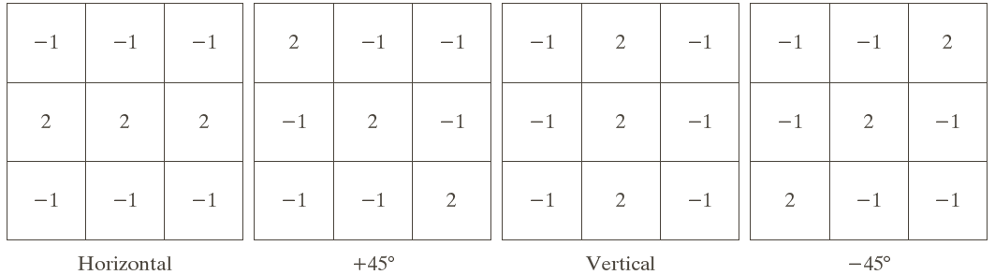
Line Detection
R₁
R₂
R₃
R₄
Horizontal mask will result with max response when a line passed through the middle row of the mask with a constant background.
The similar idea is used with other masks.
note: the preferred direction of each mask is weighted with a larger coefficient (i.e.,2) than other possible directions.

Slide 11
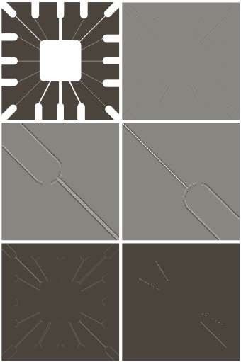
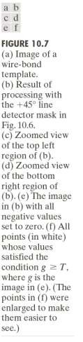
Line Detection

Slide 12
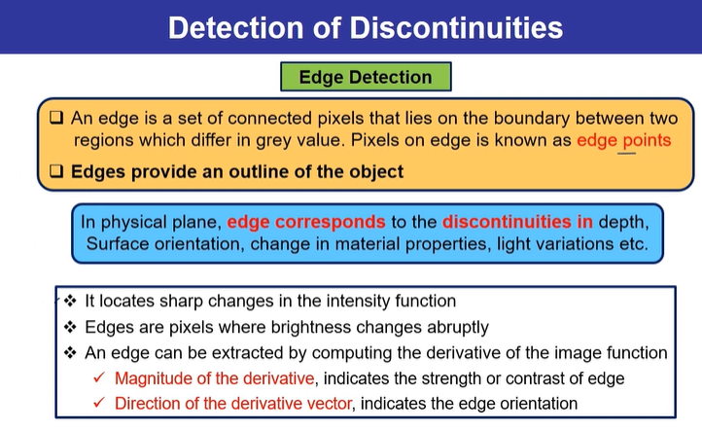

Slide 13
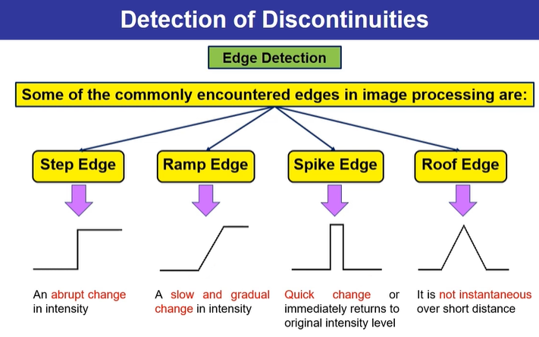


Slide 14
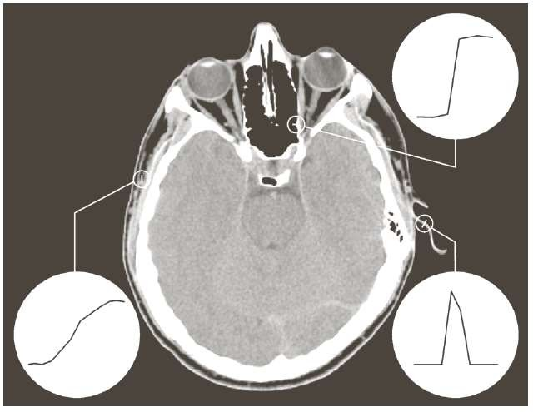
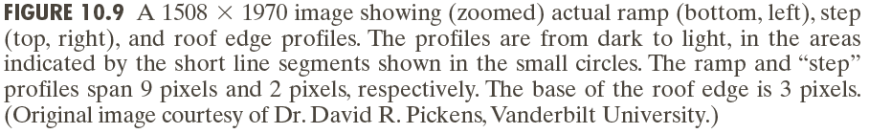
Edge Detection

Slide 15
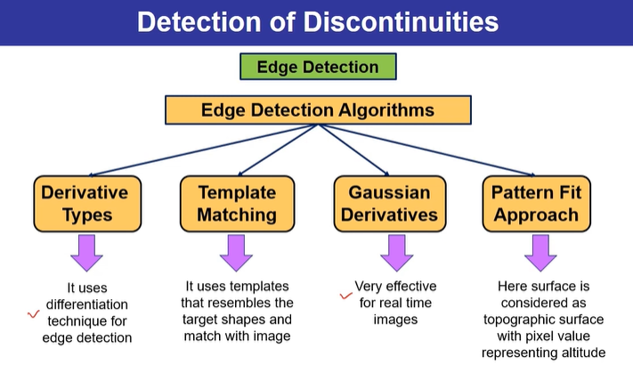

Slide 16
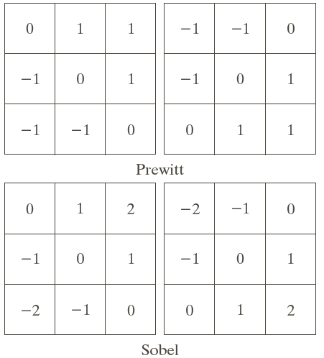
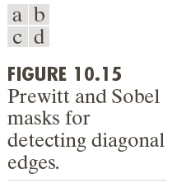

First Order Edge Detection Operator
Robert Cross Gradient Operators.
Prewitt Operator.
Sobel Operator.

Slide 17
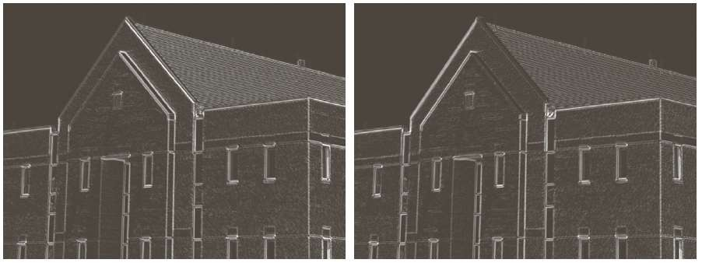
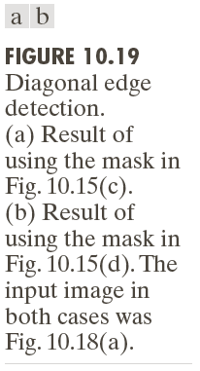
Edge Detection Eg..

Slide 18
